Slide 1
BelTox General Assembly 2019
Brussels, 21 November 2019

Slide 2
BelTox General Assembly 2019
Overview activities 2019
Overview planned activities 2020
Financial balance 2019
Membership
European Register of Toxicologists (ERT)
Why become a member of BelTox
Social media

Slide 3
Activities 2019 (1)
Courses and Workshops:
18-22 February, 2019:
UCLouvain-BelTox course of toxicology, Module 1, Principles of Toxicology.
Organized at the UCLouvan campus in Louvain-la-Neuve.
Theoretical part of 3.5 days covering essential subdisciplines of toxicological sciences and a practical part of 1.5 days.
The course was attended by 18 participants from industry, consultation, authorities and academia.
19 March, 2019:
Introductory course in toxicology, ecotoxicology and risk assessment for the Association of the Chemical Industry in Belgium (Essenscia), within the context of their product stewardship training courses.
General toxicology, in vivo and in vitro toxicology, in silico toxicology, ecotoxicology, exposure assessment, health and environmental risk assessment as well as regulatory toxicology with specific attention to REACH and CPL.
The meeting was attended by 25 participants.

Slide 4
Activities 2019 (2)
Courses and Workshops (cont’d):
21-25 October 2019:
Module 3 of the UCLouvain-BelTox course on regulatory toxicology.
Organized in the Metals Conference Centre in Brussels.
Chemicals regulations (EU and beyond) with specific attention to hazard assessment, exposure assessment, risk assessment, risk management, risk and hazard communication, GLP and chemicals registration (REACH). Also chemicals legislation outside the EU and other regulations such as biocides, foodstuffs and medicines (world café format) were addressed to a lesser extent.
The course was attended by 18 participants from industry, consultation, authorities and academia.
Annual Meeting:
21-22 November, 2019:
“Tools for 3Rs testing“.
This symposium is jointly organized by BelTox, the IC3Rs platform of the VUB and INVITROM at the Life Sciences campus of the VUB.
Young scientists are invited to compete for the best presentation and poster.
The following day there will be a workshop focusing on the design of research projects according to the 3Rs principles.
More than 130 people are attending the meeting.

Slide 5
Planned Activities for 2020 (1)
Courses and Workshops:
18 February, 2020:
Introductory course in toxicology, ecotoxicology and risk assessment.
Organized for CEFIC and Essenscia members in collaboration with CEFIC and Essenscia.
The course will take place at the CEFIC premises in Brussels.
5-10 April, 2020:
Module 4 of the UCLouvain-BelTox toxicology course.
Methods applied in in vitro toxicology for the safety testing of chemicals, in collaboration with ESTIV.
The course will take place at the UCLouvain campus in Woluwe.
October, 2020:
Module 5 of the UCLouvain-BelTox course on occupational toxicology.

Slide 6
Planned Activities for 2020 (2)
2-day Annual Meeting 2020 (proposed programme):
November, 2020, 1st day:
Symposium on cancer hazard and risk assessment.
Young scientist competition.
November, 2020, 2nd day:
Workshop on cancer hazard and risk assessment with discussion of real cases.
Practical exercises on cancer modes of action and assessment of human relevance of rodent cancer data.

Slide 7
Financial Balance 2019
In € |  | Out €
Sponsorship + bank interests + website | 4,025.08 | Administration + bank charges + bursaries | 10,041.70
Membership | 5,450.00 | Website | 3,789.76
AM | 7,354.00 | AM | 1,484.00
Courses | 3,500.00 | Courses | 500.00
EUROTOX 2018 | 30,444.16 | EUROTOX 2018 | 20,500.00
ERT | 1,220.00 | ERT | 1,640.84
Total | 51,993.24 | Total | 37,956.30

Slide 8
Membership November 2019

Slide 9
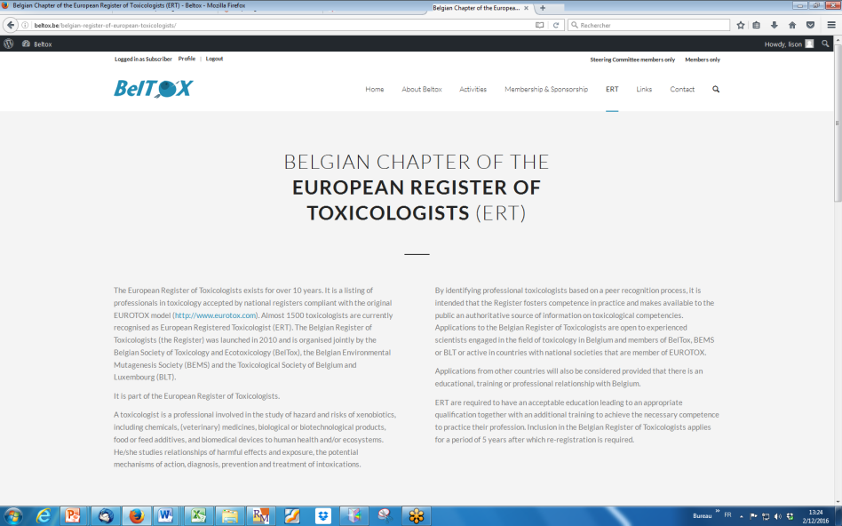
ERT 2019
Currently 72 ERT in the Belgian chapter
Board meeting of June 2019:
7 new applications approved
4 applications for renewal approved
Next board meeting: June 2020
Visit www.beltox.be

Slide 10
Why become a Member of BelTox?
Reduced rates for participation in all BelTox, EUROTOX and SETAC events (annual meeting, workshops, courses)
Online access to abstracts and presentations of attended BelTox events
Become a member of the Steering Committee and help to determine the course of the Society
Automatic membership of the European Society of Toxicology (EUROTOX)
Free subscription to the BelTox newsletter with information on upcoming events in the world of toxicology and vacancies for toxicologists
Get acquainted with other fields in toxicology than the one you are active in
Help in the development of young scientists
Seek advice from peers on toxicology questions via the contact page or during BelTox events
Networking opportunities

Slide 11
BelTox on social media
Join us and become active on our social media
LinkedIn
Facebook

